Slide 1
Cef 440: INTERNET PROGRAMMING (J2EE) AND MOBILE PROGRAMMING supervisor: dr. nkemeni valery
Road Sign and Road State Mobile Notification
Application
w/ GROUP 14

Slide 2
Task II Requirement gathering

Slide 3
Agenda
Introduction
Stages of the Requirement Gathering Phase
Conclusion
References

Slide 4

Introduction What is Requirement gathering?... 🤔

Slide 5
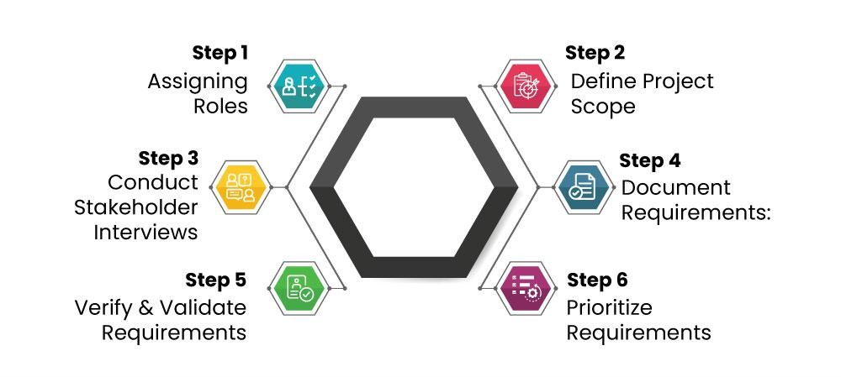
STAGES OF REQUIREMENT GATHERING

Slide 6
Stage 1
Assign roles
Internal Stakeholders
External Stakeholders

Slide 7

Stage 2 define project scope
“Delivering road sign information and road state notification to drivers in a convenient and user friendly manner”

Slide 8

stage 3 Conduct interviews
Getting the users response

Slide 9
Interview questions
What do you think would reduce the rate of accidents?
How frequently do you encounter road signs while driving?
On a scale of 1 to 5, how important do you consider being informed about upcoming road signs while driving?
Have you ever missed or misunderstood a road sign while driving?
Would you find a system that notifies you about upcoming road signs useful?
How confident are you in your ability to notice and understand road signs while driving?

Slide 10
Answers to interview
If one could get a heads up when we approaching a sharp turns, slippery roads and speed bumps before time, it will provide time to adjust
I encounter road signs regularly, especially during my daily commute and when traveling on highways.
I would rate it a 4. It's essential to be aware of upcoming road signs to make informed driving decisions and ensure safety.
Yes, there have been instances where I missed or misunderstood road signs, especially when driving in unfamiliar areas or during poor weather conditions.

Slide 11

Stage 4 Document requirements
Functional requirements
Non-functional requirements

Slide 12
FUNCTIONAL REQUIREMENTS
GPS Location Tracking
Road Sign Database
Real-time Data Integration
Customizable Notifications
Authentication and User Management

Slide 13
Non-functional requirements
User-friendly Interface
Performance
Reliability
Security
Scalability
Maintainability
Compatibility
Regulatory Compliance

Slide 14

Stage 5 Verify and validate requirements

Slide 15

Stage 6 Prioritize Requirements
High Priority
Medium Priority
Low Priority
Future Considerations

Slide 16
High priority (Must have)
Authentication and User Management
GPS Location Tracking
User-Friendly Interface
Compatibility

Slide 17
Medium Priority (Should have)
Real-Time Data Integration
Road Sign Database
Customizable Notifications

Slide 18
Low Priority (Could have)
Performance
Scalability
Maintainability

Slide 19
Future Considerations (Won’t have this time)
Regulatory Compliance

Slide 20
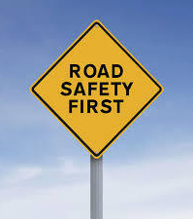
conclusion
These requirements and user stories will guide the design and implementation of the Road Sign and Road State Mobile Application.
Further requirements may emerge as the project progresses.

Slide 21
references
https://www.geeksforgeeks.org/requirements-gathering-introduction-processesbenefits-and-tools/
https://www.geeksforgeeks.org/designing-google-maps-system-design/
https://www.nuclino.com/articles/functional-requirements
https://www.geeksforgeeks.org/non-functional-requirements-in-softwareengineering

Slide 22
Members
NAME | MATRICULE
ABO STEVE AKUM | FE21A125
CHINEPOH DIVINE-FAVOUR | FE21A159
JENNA EBOT AGBOR | FE21A205
LANGEH MOHAMMED YIENEH | FE21A223
NDEH TAMINANG | FE21A246

Slide 23

Thank you
Github: https://github.com/Langeh03/Group14

